Slide 1
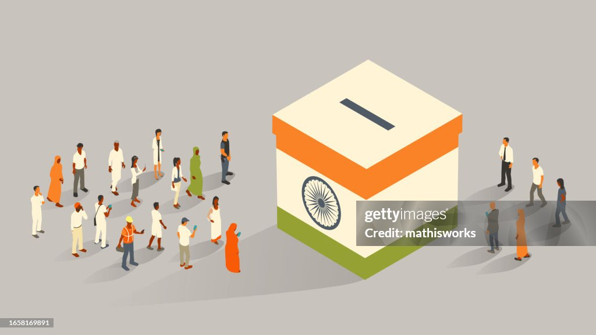
Election Results-2024
Analysis with Power BI
Vaghela Divyesh A.

Slide 2
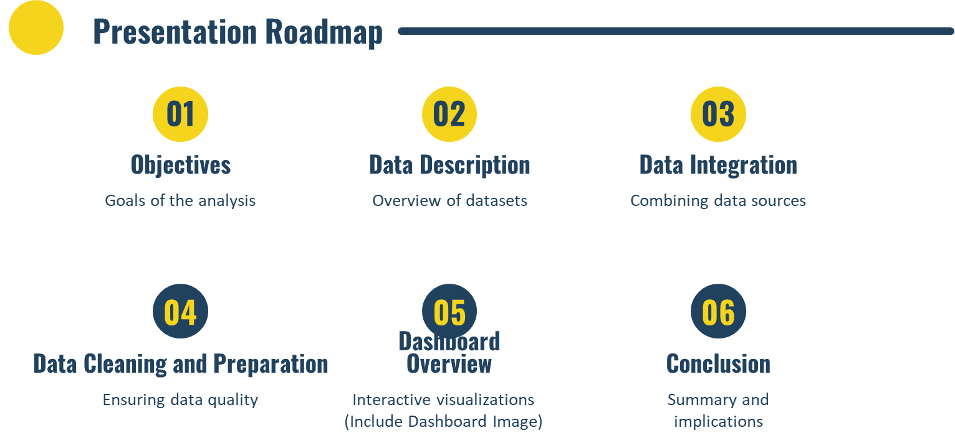

Slide 3
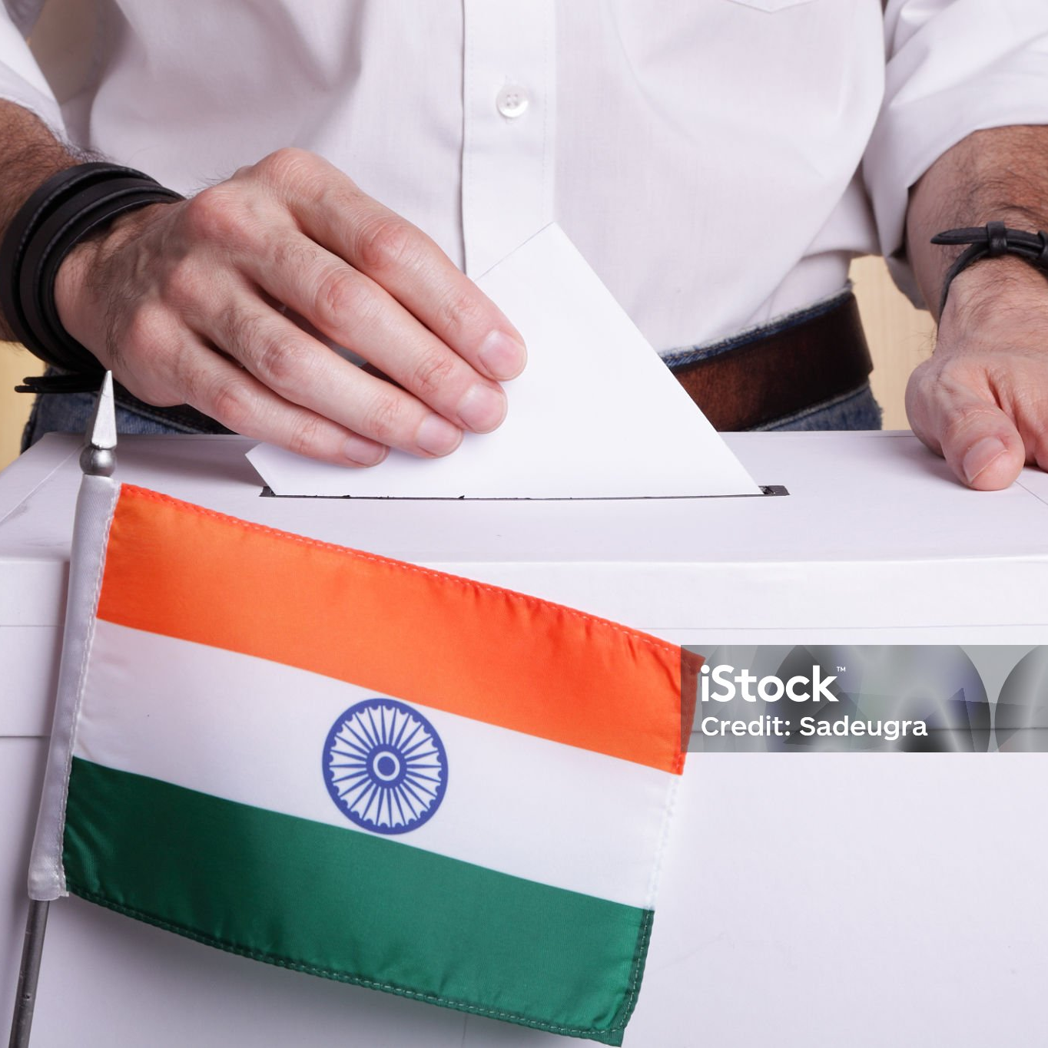
Objective
The objective is to analyze the 2024 election data to gain insights into the election results, understand party performance and voter trends across various constituencies, and create interactive visualizations and dashboards for stakeholders.

Slide 4
Data Description

Slide 5

Result data Set
2024
id: Unique identifier for each record.
State: Name of the state
Result Data sets
Const. No.: Constituency number.
Constituency: Name of the constituency.
Leading Candidate: Name of the leading candidate.

Slide 6
Result data Set
2024
Leading Party: Name of the leading party.
Alliance Name: Name of the political alliance the party belongs to.
Result Data sets
Party Name: Name of the political party.
Trailing Candidate: Name of the trailing candidate.
Trailing Party: Name of the trailing party

Slide 7
Data Integration

Slide 8
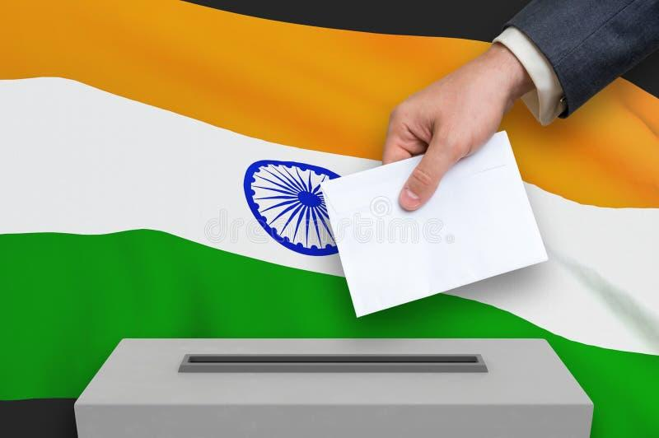
About Data Integration
We combined the election results data with the party alliance data to form a comprehensive dataset. This integration provides a detailed view of which alliances are leading or trailing in various constituencies, allowing for a thorough analysis of political power distribution and voter preferences. This holistic approach offers valuable insights into the dynamics between political alliances and their impact on the election outcomes.

Slide 9
Data Cleaning and Preparation

Slide 10
Check Data: Identify and address missing values and inconsistency.
Correct Error:Fix error to ensure dataset accuracy.
Prepare data :Standardize column name and fill missing values.
Examples:Correct column name and fill missing values for completeness.

Slide 11
Dashboard Overview

Slide 12
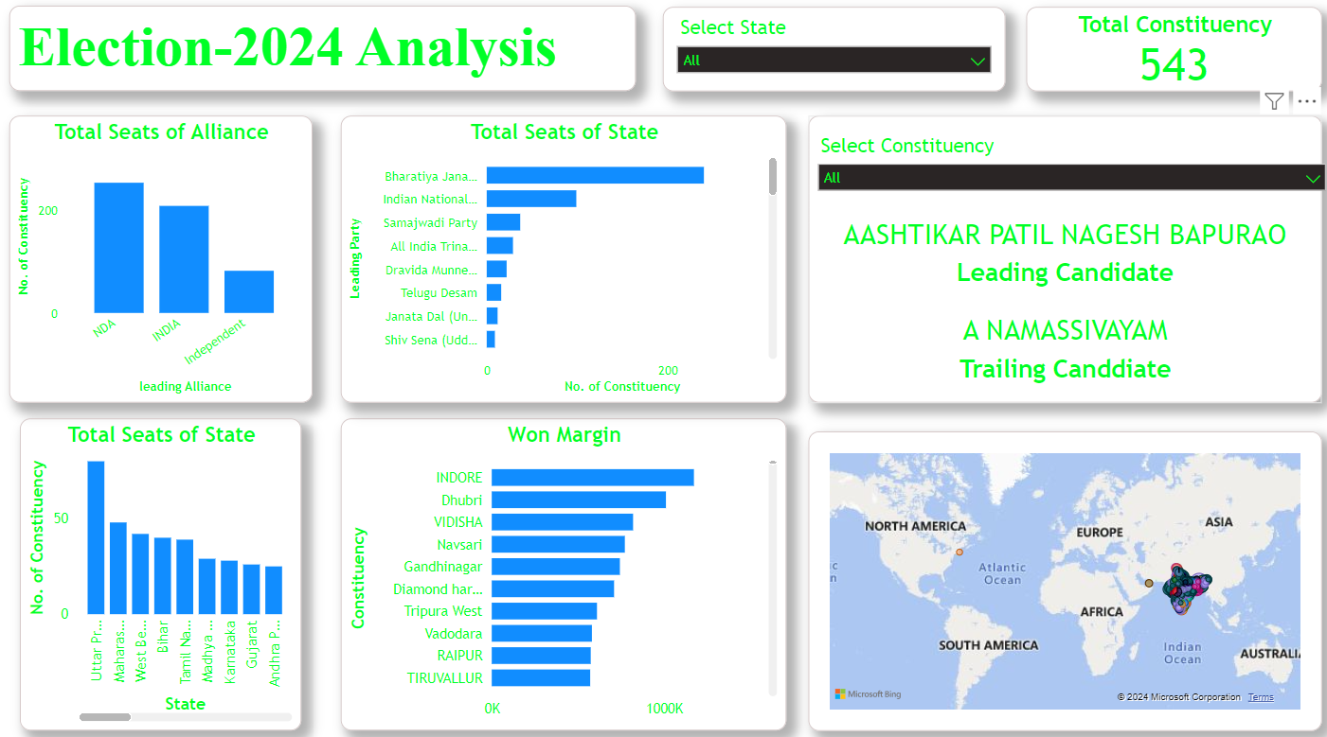
Dashboard Image

Slide 13
Conclusion

Slide 14
Final Conclusion
The analysis of the 2024 election data provides comprehensive insights into party performance and voter trends across constituencies. The interactive dashboard created in Power BI allows stakeholders to explore detailed election outcomes and dynamics between political alliances, aiding strategic decision-making for future elections.

Slide 15

Vagheladivyesh482@gmail.com

